Slide 1
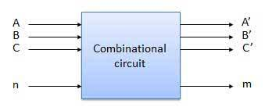
Unit 2: Combinational Logic Circuits

Slide 2
Introduction
The logic operations and Boolean algebra have already been discussed earlier.
The Boolean theorems and De-Morgan's theorems are useful in manipulating the logic expressions. We can then realize the logical expressions using gates.
The number of logic gates required for the realization of a logical expression should be reduced to the minimum possible value.
This is possible if we can simplify the logical expressions. In this chapter we will discuss one of the simplification techniques called Karnaugh map or K-map.

Slide 3
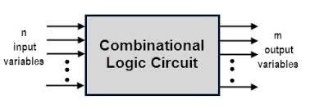
Combinational circuits :
A combinational circuit is a logic circuit, the output of which depends only on the combination of the inputs.
The output does not depend on the past value of inputs or outputs.
Hence combinational circuits do not require any memory.
The block diagram of a combinational circuit is shown in Fig.

Slide 4
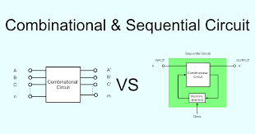
Classification of Digital Circuits :
The digital systems in general are classified into two categories namely:
1. Combinational logic circuits
2. Sequential logic circuits.

Slide 5
Examples of combinational circuits :
Following are the examples of some combinational circuits:
1. Adders, subtractors 2. Comparator
3. Code converters
4. Encoders, decoders
5. Multiplexers, demultiplexers

Slide 6
SOP and POS Representations for Logic Expressions :
Consider that the logic expression given to us is as follows:
Y =AC+ BC
Then it can be realized using basic gates as shown in Fig
In this Boolean expression, Y is the result or output and A, B,C are called as literals.
Any logic expression can be expressed in the following two standard forms:
1. Sum-of-products form (SOP) and
2 Product-of-sums form (POS)
These two forms are suitable for reducing the given logic expression to its simplest form.

Slide 7
1. Sum-of-products form (SOP)
Y =ABC+BCD+ABD
A = XY+XY+XỸ
Y = PO+POR + POR
2 Product-of-Sums form (POS)
Y = (A+B+C).(A + B).(A + C)
A = (X+Y). (X+Y+Z)
Y = (P+R).(P+Q). (P+R)
Z=(A+B).(C+D)

Slide 8
Standard Form-In this form each term may contain one, two or any number of literals. It is not necessary that each term should contain all the literals
Canonical Form-This rule states that each term used in a equation must contain all the available input variables.
Sr.No | Expression | Type
1 | Y=AB+ ABC + ABC | Standard SOP
2 | Y=AB+AB+AB | Canonical SOP
3 | Y=(A+B).(A+B).(A+B) | Canonical POS
4 | Y=(A+B).(A+B+C) | Standard POS

Slide 9
Concept of Minterm and Maxterm
Minterm- Each individual term in the canonical SOP Form is called as Minterm
Maxterm- Each individual term in the canonical POS form is called as maxterm.
Canonical SOP –Y=ABC+ABC+ABC each individual term is minterm
mo m1 m2
Canonical POS-Y=(A+B).(A+B)
M0 M1

Slide 10
Conversion from Standard SOP to Canonical SOP form :
Steps to be followed:
Step 1: For each term in the given standard SOP expression find the missing literal.
Step 2: Then AND this term with the term formed by ORing the missing literal and its complement.
Step 3: Simplify the expression to get the canonical SOP expression

Slide 11
Convert the expression Y = AB + AC + BC into the canonical SOP form :
Soln. :
Step 1: Find the missing literal for each term :
Y= AB+ AC + BC
Missing literal → C B A
Step 2: AND each term with (Missing literal + Its C(complement) :
Y=AB.(C+C) + AC.(B+B) + BC.(A + A)
(Missing literal + Its complement)
Original product term
Step 3: Simplify the expression to get the canonical SOP :
Y = AB (C+C) + AC (B+B) + BC (A+Ā)
= ABC + ABC + ABC + ABC + ABC + ABC
= (ABC + ABC) +(ABC+ AB C) + ABC + AB C
But A +A=A & (ABC + ABC) = ABC and (ABC + ABC) = ABC
:: Y = ABC + ABC + ABC + ABC Canonical SOP form
Each term contains all the literals

Slide 12
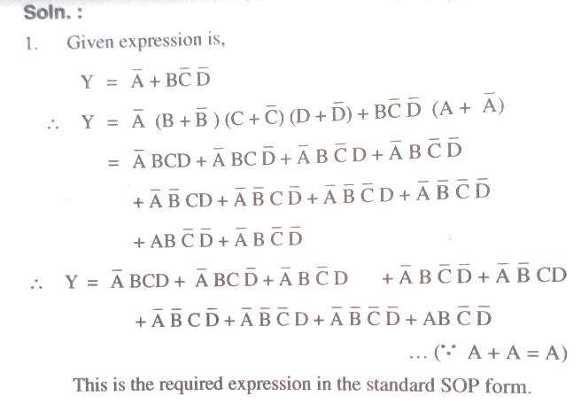

Slide 13
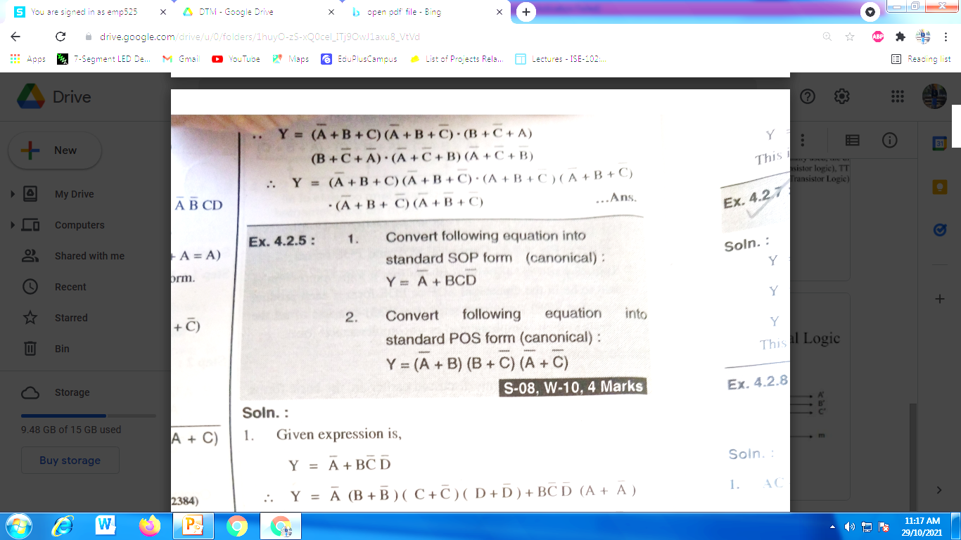
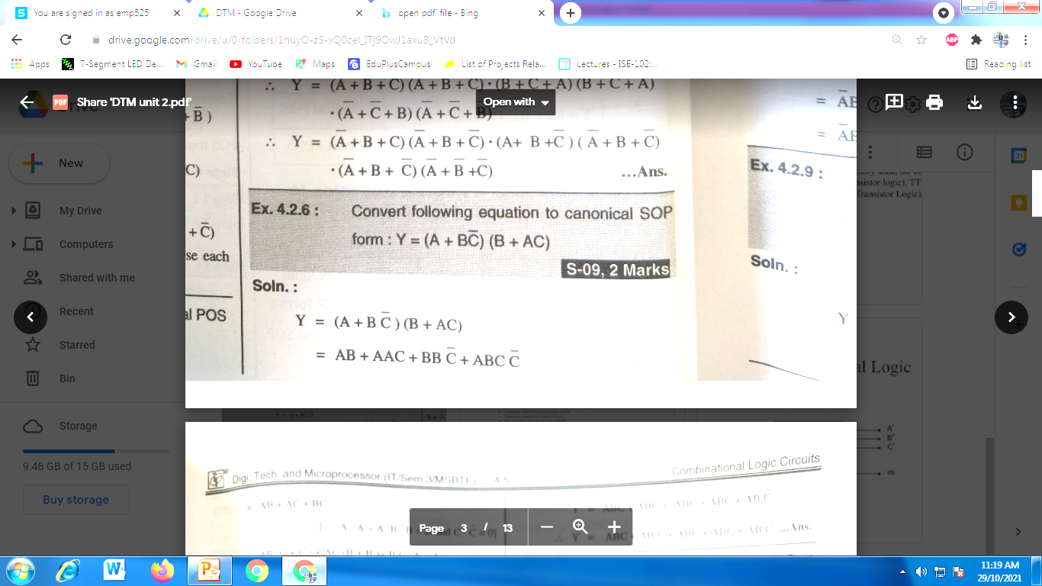
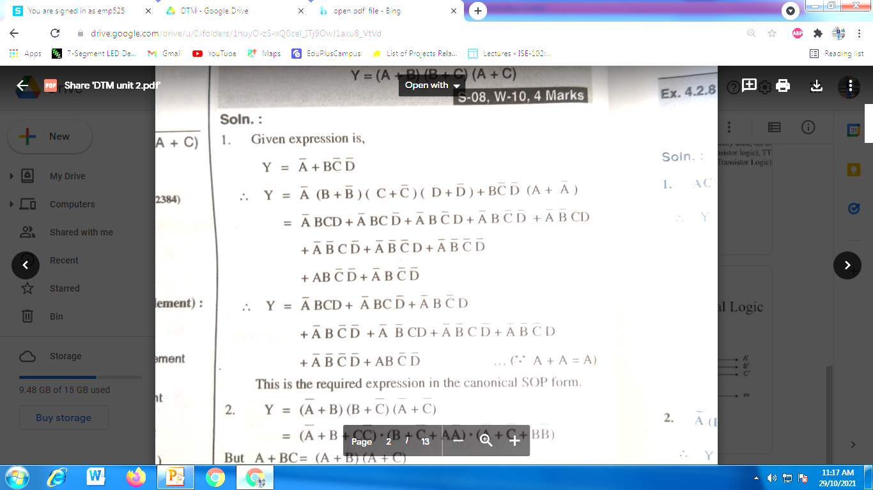
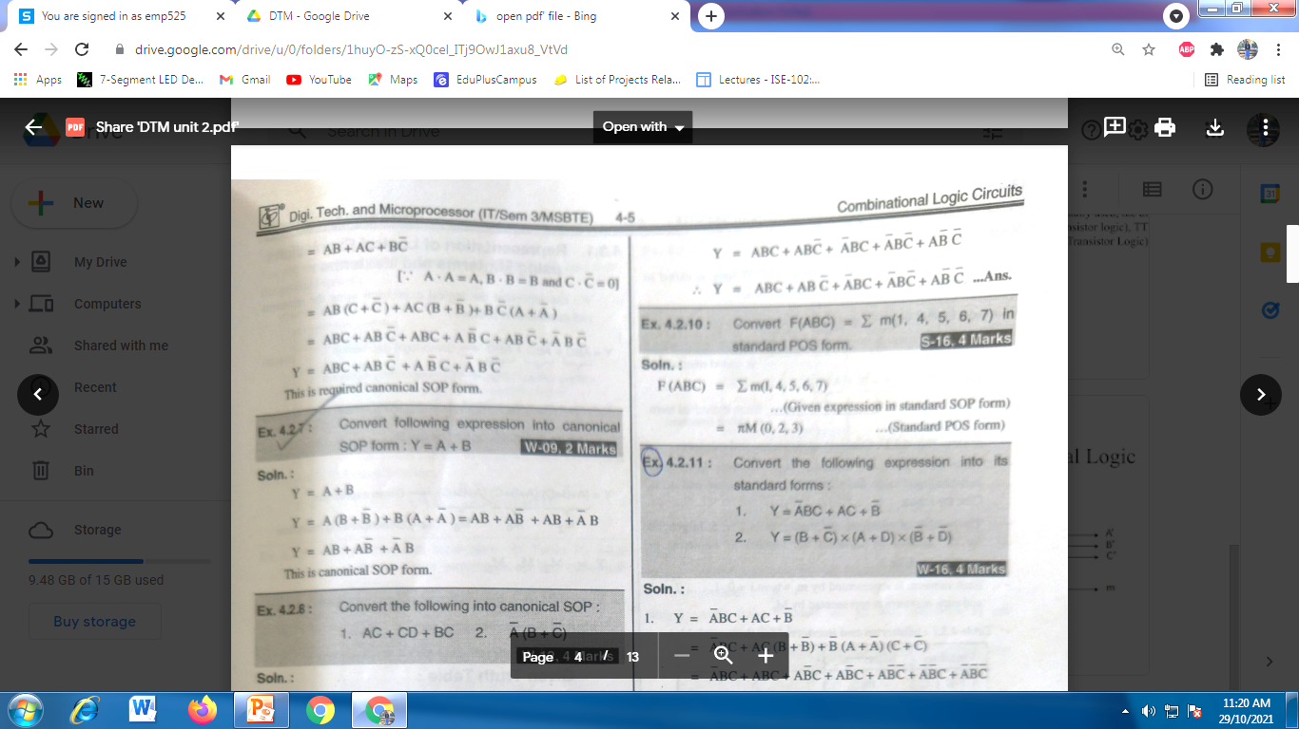
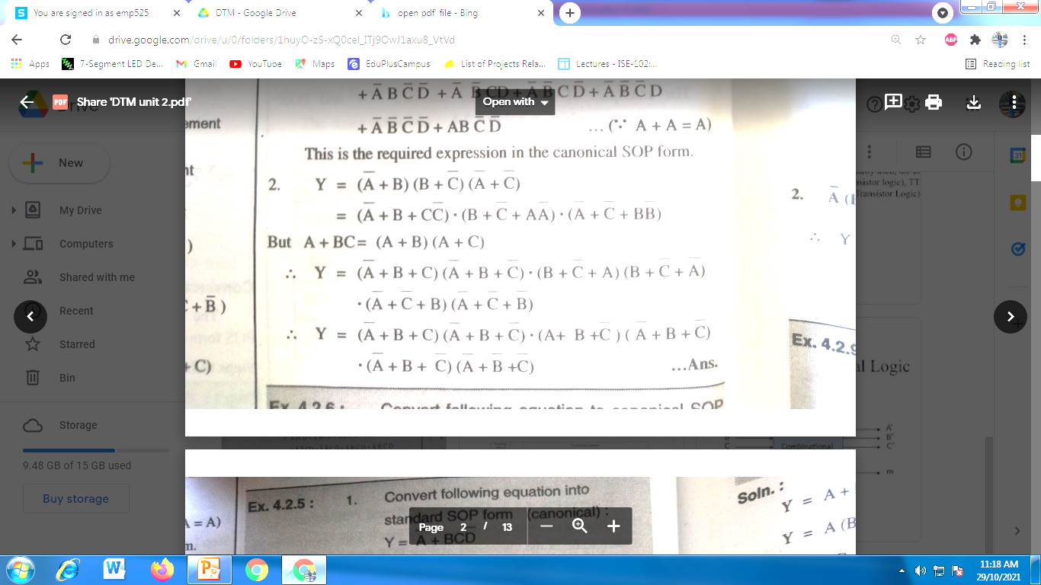

Slide 14
Conversion from standard POS to canonical POS form :
Steps to be followed:
Step 1: For each term find the missing literal
Step 2: Then OR each term with the term formed by ANDing the missing literal in that term with its complement.
Step 3: Simplify the expression to get the canonical POS

Slide 15
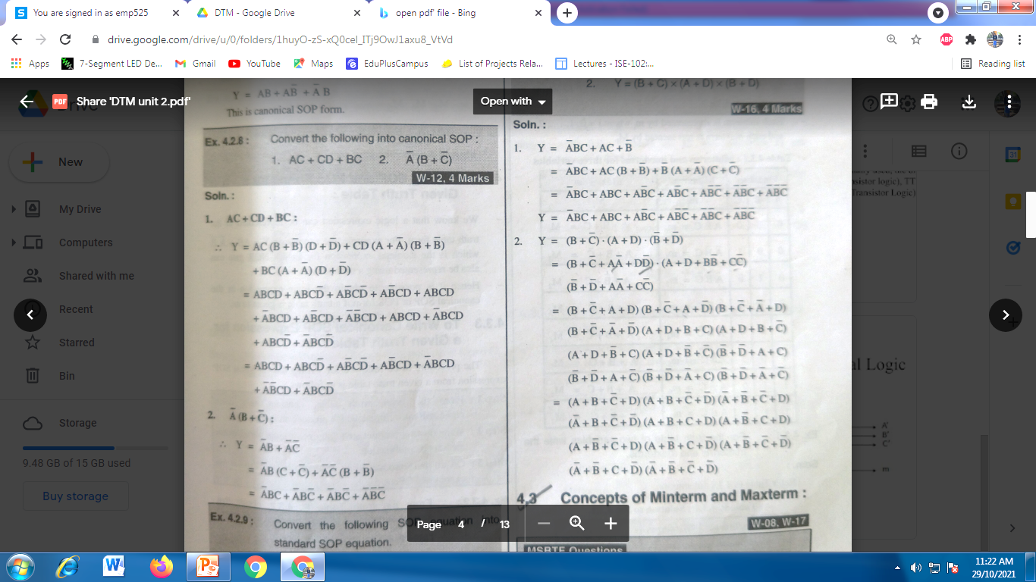
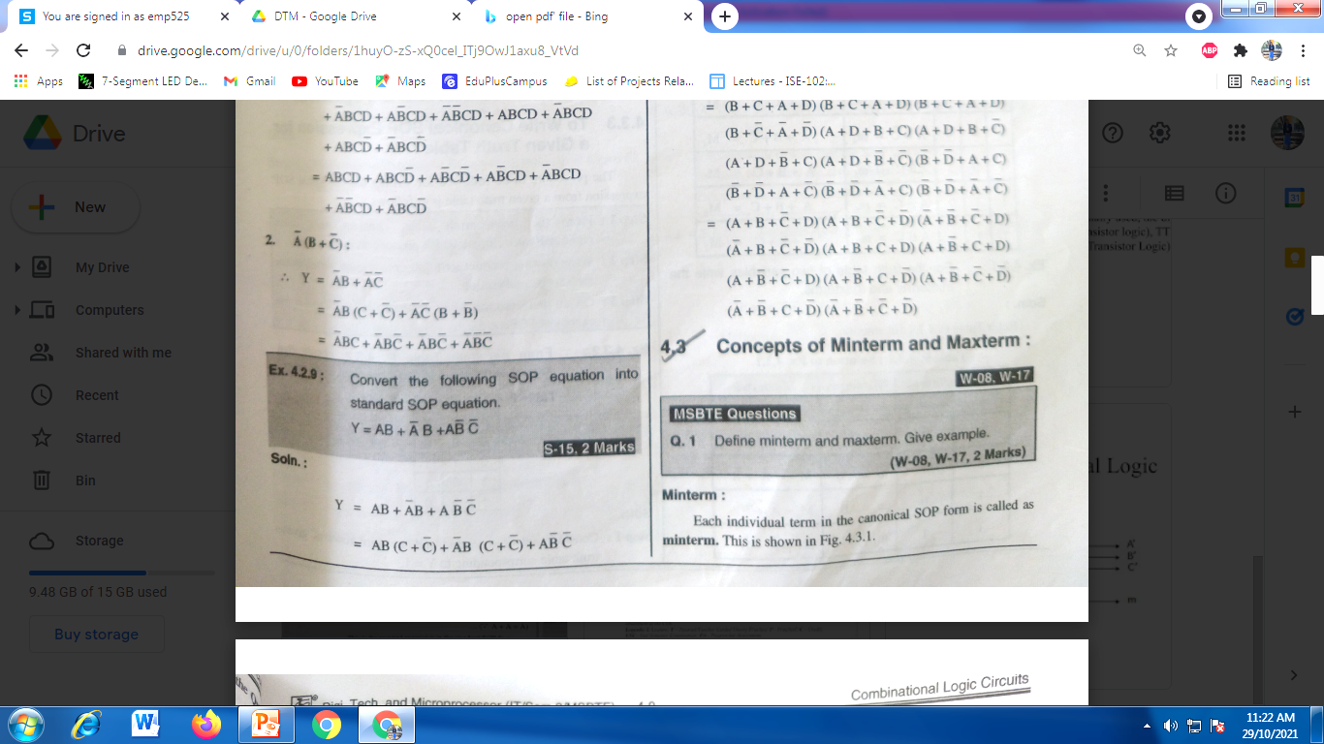
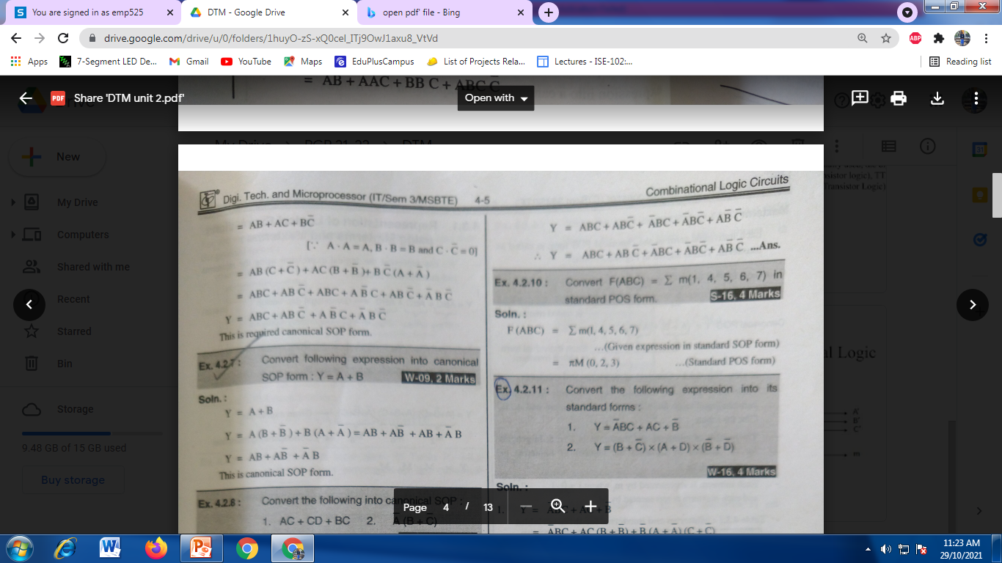

Slide 16
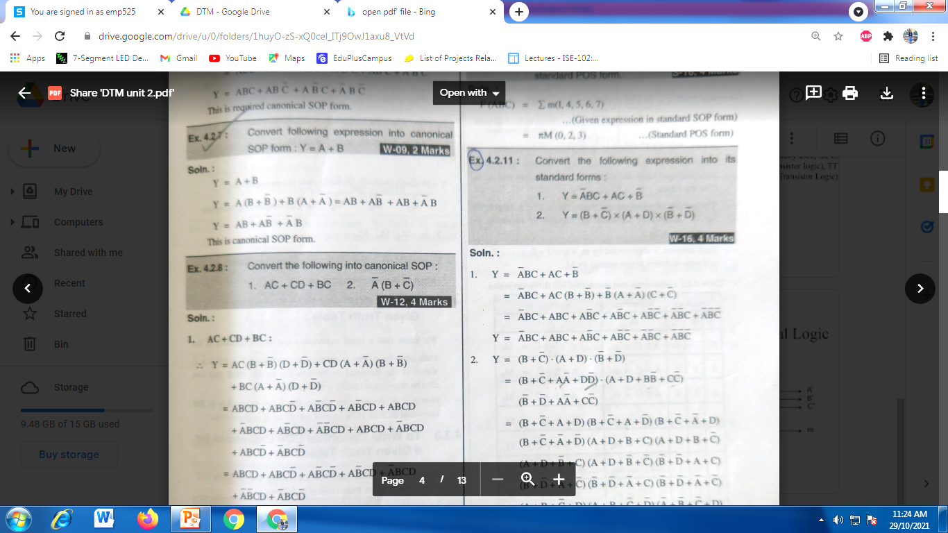
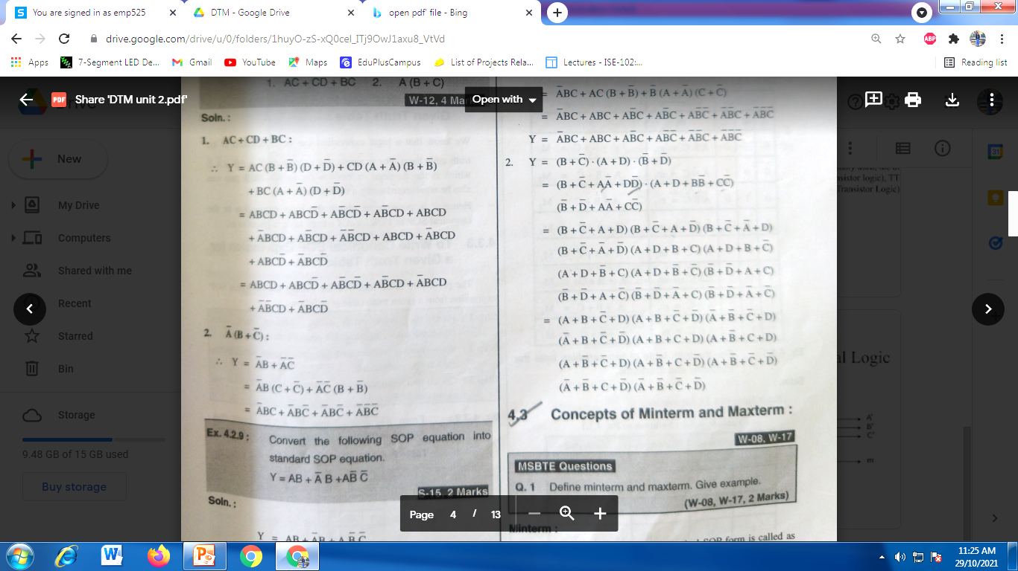

Slide 17
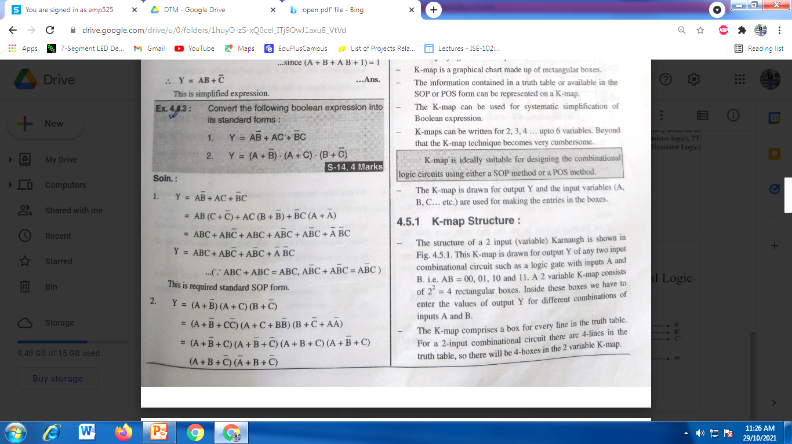
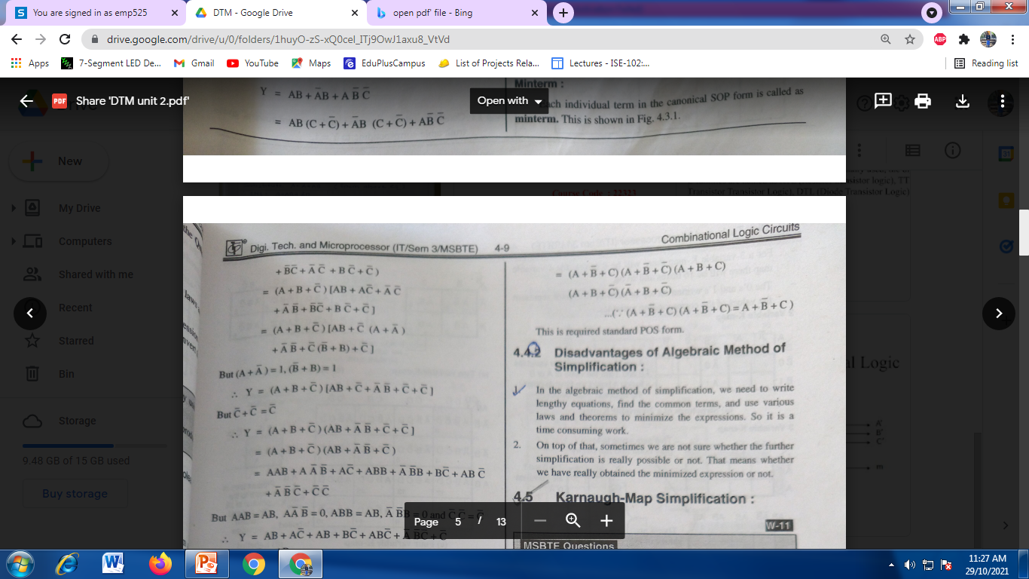

Slide 18
Karnaugh-Map Simplification : What is K-map ? Explain the rules to simplify
This is another simplification technique to reduce the Boolean equation.
It overcomes all the disadvantages of the algebraic simplification technique.
K-map (short form of Karnaugh map) is a graphical method of simplifying a Boolean equation.
K-map is a graphical chart made up of rectangular boxes.
The information contained in a truth table or available in the
SOP or POS form can be represented on a K-map. The K-map can be used for systematic simplification of Boolean expression.
K-maps can be written for 2, 3, 4 ... upto 6 variables. Beyond that the K-map technique becomes very cumbersome.
K-map is ideally suitable for designing the combinational logic circuits using either a SOP method or a POS method.

Slide 19
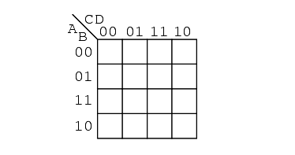
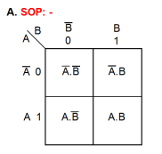
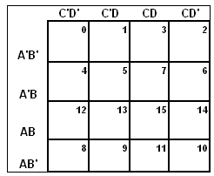
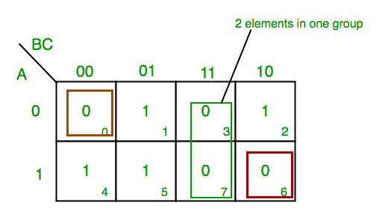
K-map Structure
2 variable k map 4 variable k map
3 variable k map

Slide 20
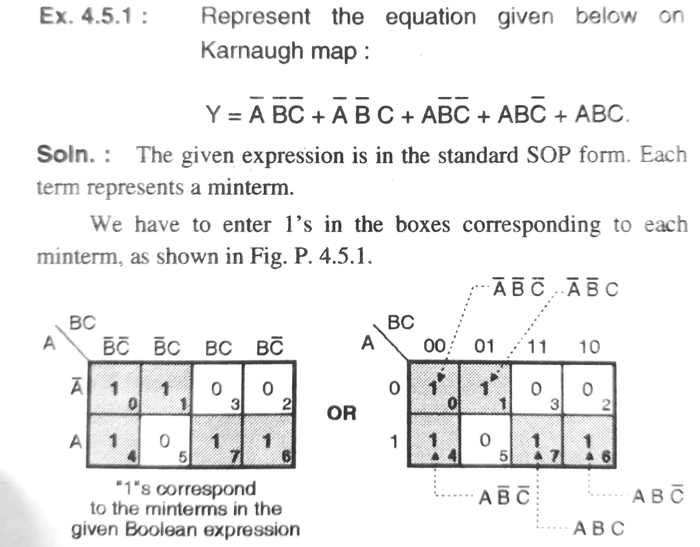

Slide 21
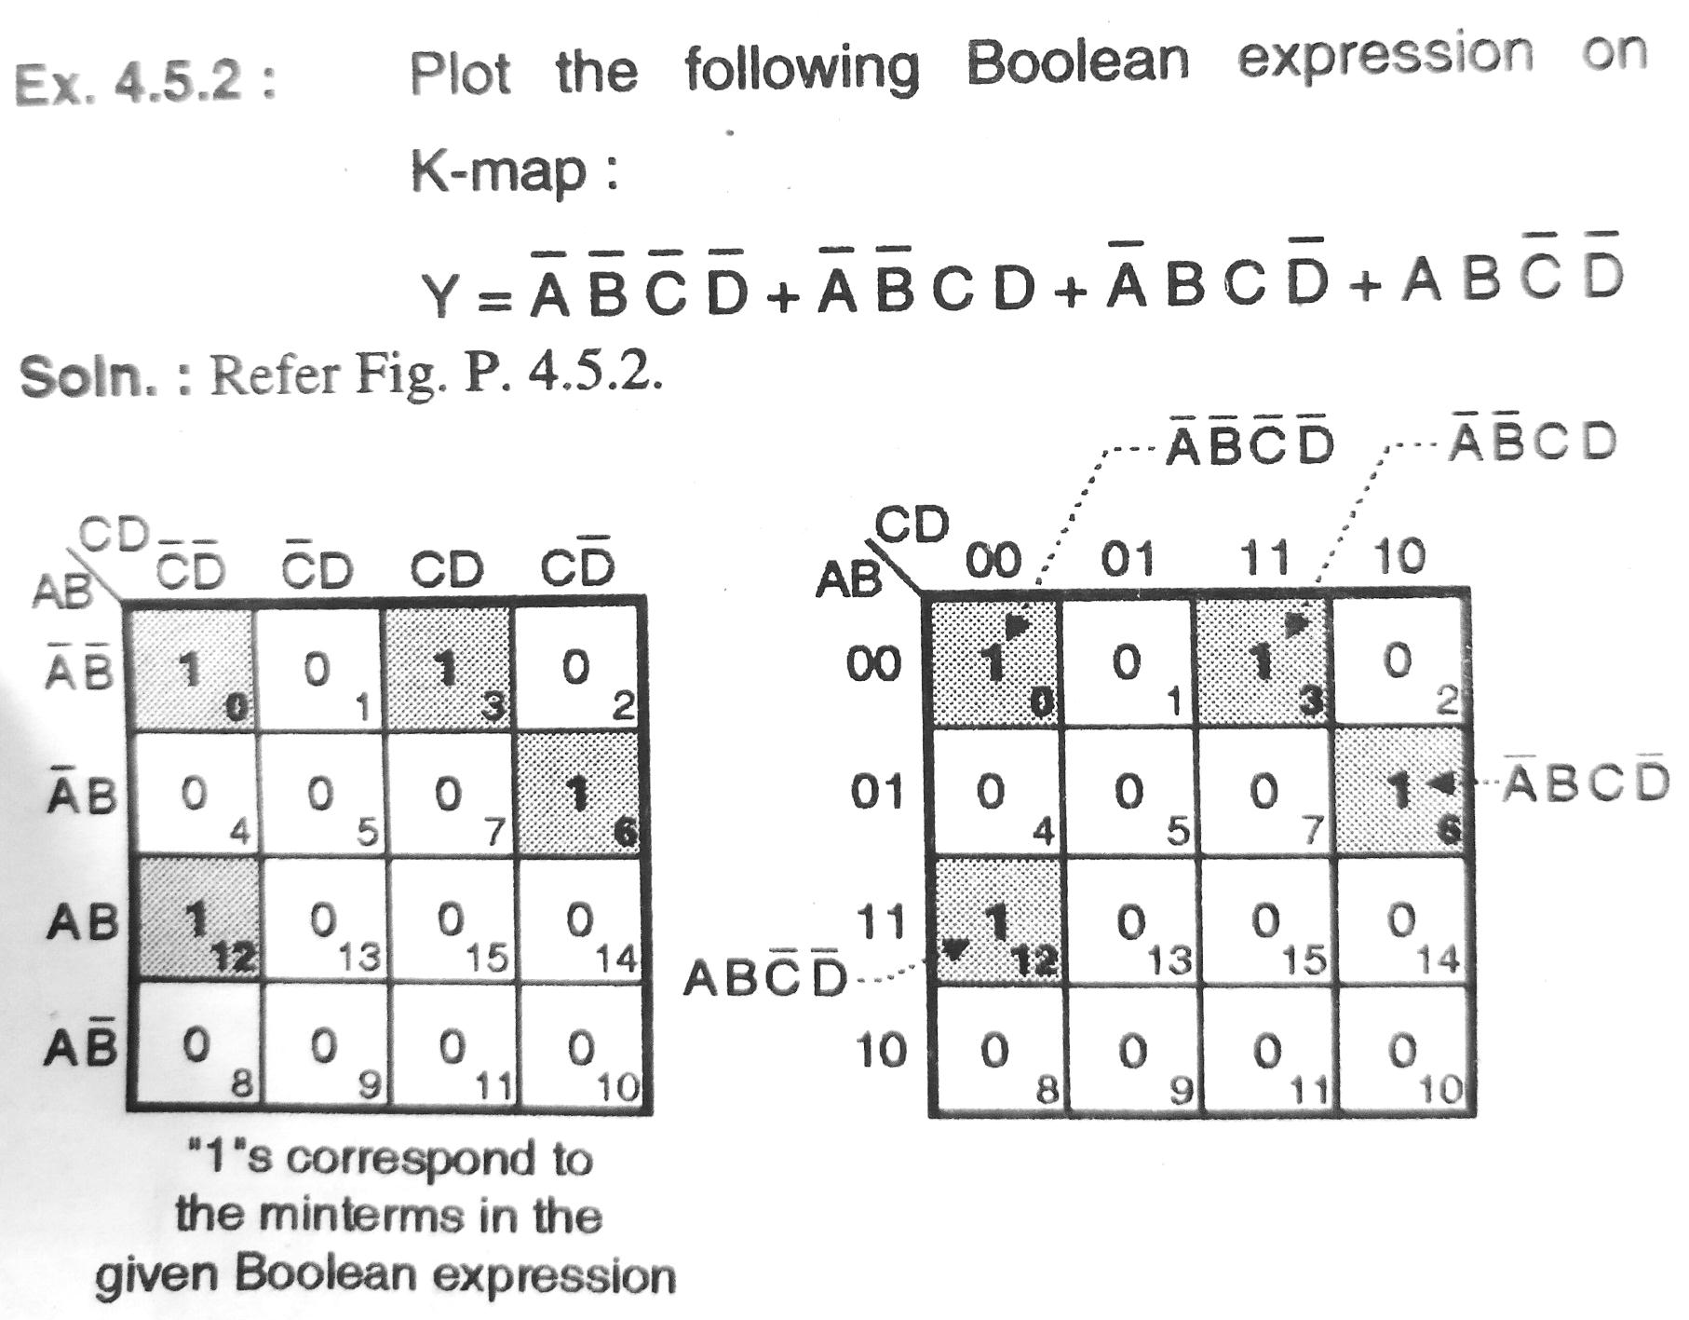

Slide 22
Way of Grouping (Pairs, Quads and Octets):
While grouping, we should group most number of 1's (or 0's).
The grouping follows the binary rule i.e. we can group 1, 2, 4, 8, 16, 32 number of l's or 0's. We cannot group 3, 5, 7, .... number of 1's or 0's.
Pairs: A group of two adjacent 1's or 0's is called as a pair.
Quad: A group of four adjacent l's or 0's is called as a quad.
Octet: A group of eight adjacent l's or 0's is called as octet.

Slide 23
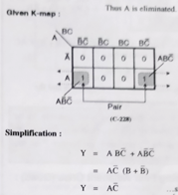
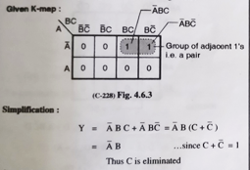
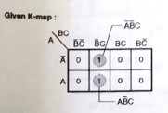
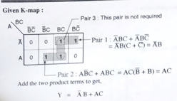
Grouping of 2 Adjacent Ones

Slide 24
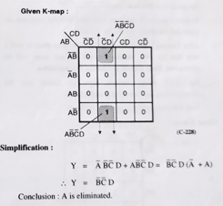
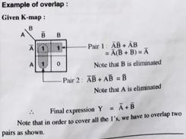

Slide 25
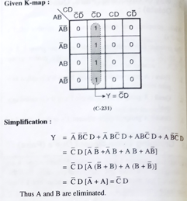
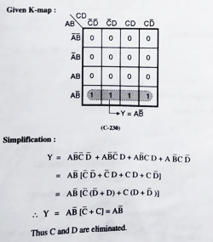
Grouping of 4 Adjacent Ones

Slide 26
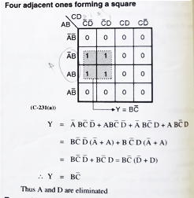
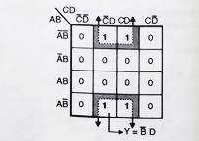

Slide 27
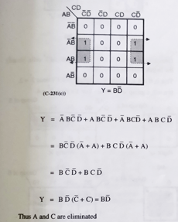
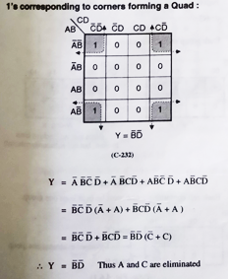
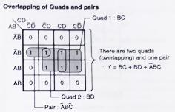

Slide 28
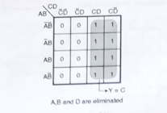
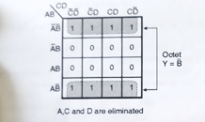
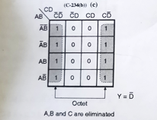
Grouping of 8 Adjacent Ones

Slide 29
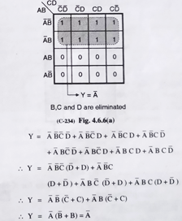

Slide 30
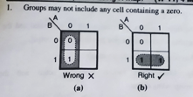
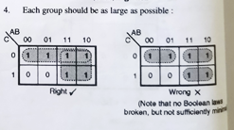
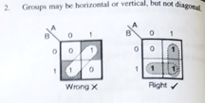
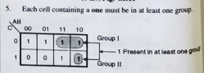
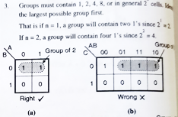
Rules followed for K-Map Simplification

Slide 31
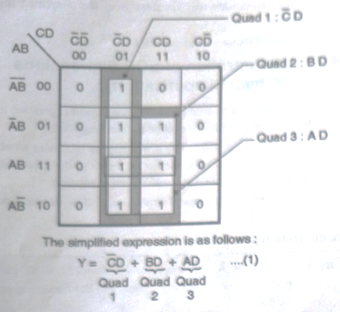
For the logical expression given below draw the K-map and obtain the simplified logical expression:
Y = Σm (1, 5, 7, 9, 11, 13, 15). Realize the minimized expression using the basic gates.

Slide 32
Examples
2. Using K-map realize the following expression using minimum number of gates : Σm (1, 3, 4, 5, 7, 9, 11, 13, 15)
3. Simplify the following expressions using K-map :
a. f (A, B, C) = Σm (0, 1, 3, 4, 6)
b. f (A, B, C, D) = Σm (0, 1, 2, 4)

Slide 33
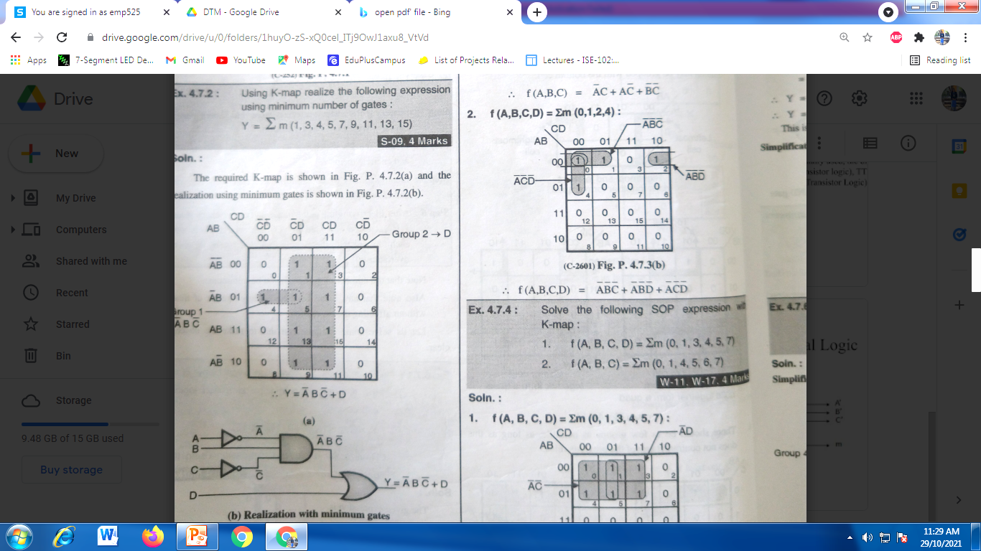
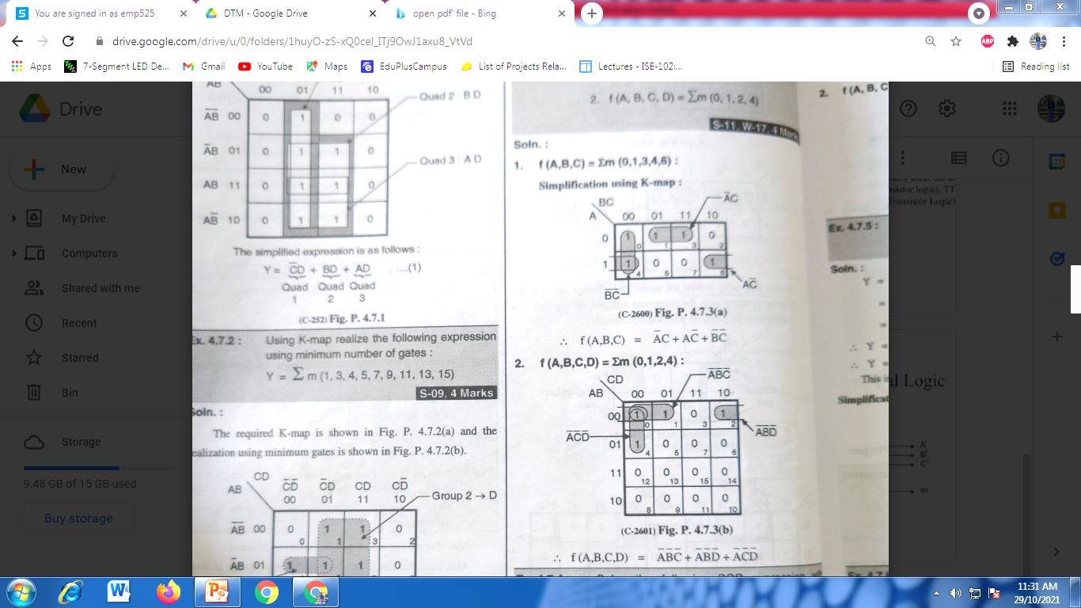

Slide 34
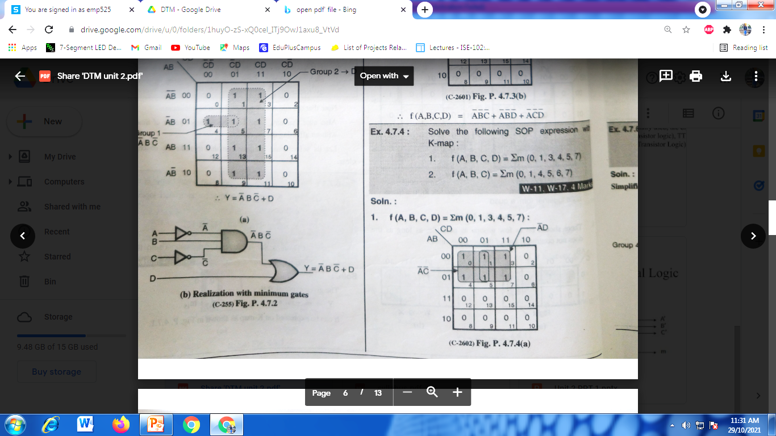
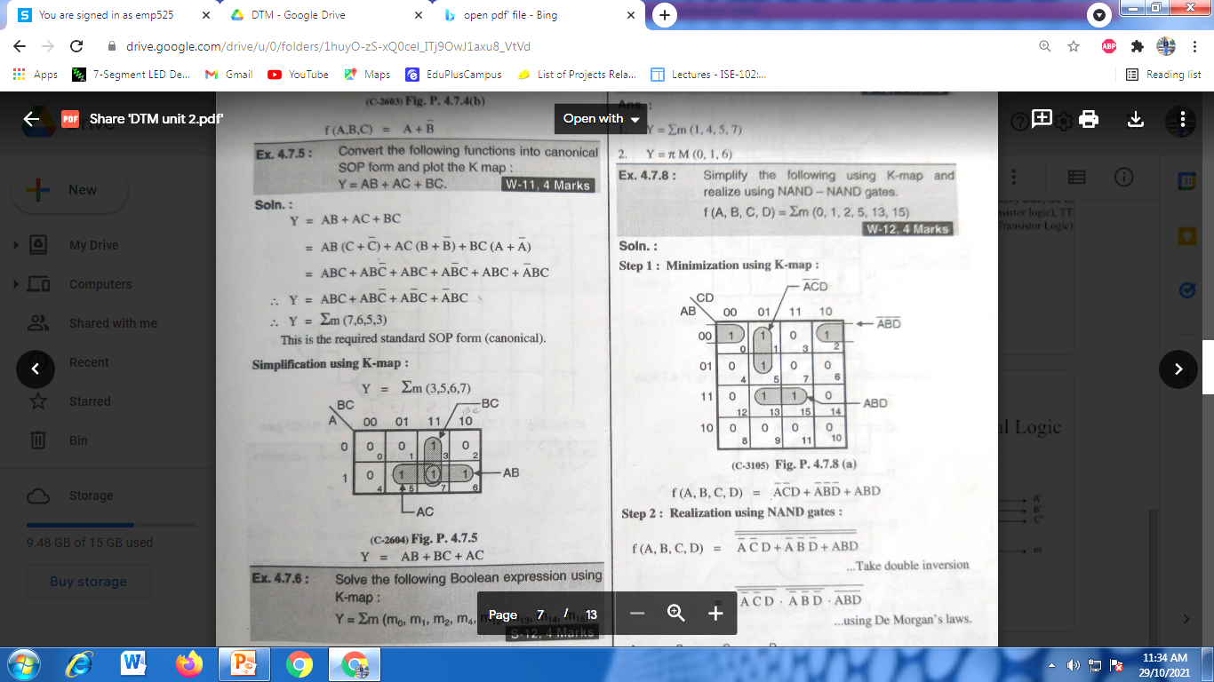
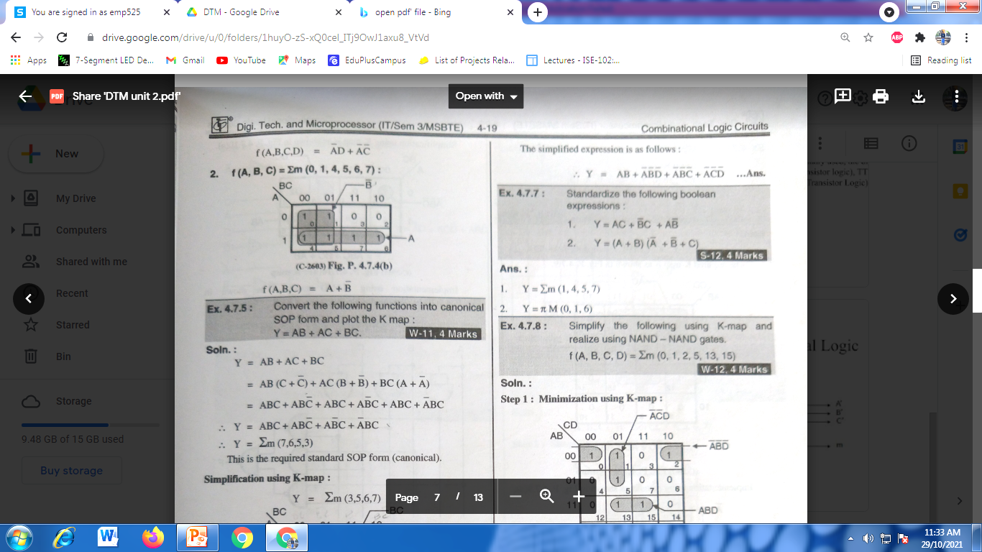

Slide 35




Slide 36


Slide 37
4.Minimize the following expressions using K-map :
Y= Σm (1,5,6,7,11,12,13,15)
F=Σm (0,1,2,3,11,12,14,15)
Soution:Simplification using K-Map is as shown below

Slide 38



Slide 39



Slide 40


Slide 41


Slide 42


Slide 43


Slide 44


Slide 45


Slide 46


Slide 47


Slide 48


Slide 49


Slide 50



Slide 51


Slide 52


Slide 53


Slide 54


Slide 55



Slide 56


Slide 57


Slide 58
Q. Design a combinational logic circuit whose output is high (1)only when majority of inputs (A,B,C,D) are low(0).
A | B | C | D | Output
0 | 0 | 0 | 0 | 1
0 | 0 | 0 | 1 | 1
0 | 0 | 1 | 0 | 1
0 | 0 | 1 | 1 | 0
0 | 1 | 0 | 0 | 1
0 | 1 | 0 | 1 | 0
0 | 1 | 1 | 0 | 0
0 | 1 | 1 | 1 | 0
1 | 0 | 0 | 0 | 1
1 | 0 | 0 | 1 | 0
1 | 0 | 1 | 0 | 0
1 | 0 | 1 | 1 | 0
1 | 1 | 0 | 0 | 0
1 | 1 | 0 | 1 | 0
1 | 1 | 1 | 0 | 0
1 | 1 | 1 | 1 | 0
Solution: Write the truth table

Slide 59
Q. Write the Boolean equation and draw logic diagram for the logic that will have output as Y and inputs A,B,C. The logic performs the following operation: 1.Y=1 when A=B=C=1 and when A=B=0 and C=1 3.Y=0 for all other cases.

Slide 60


Slide 61
Multiplexer (Data Selectors)
What are multiplexers? Draw the logical circuits and describe its working.
The term Multiplexer means many into one.
Multiplexing is the process of transmitting a large number of information over a single line.
A Digital Multiplexer (MUX) is a combinational Circuit that selects one digital information from several sources and transmits the selected information on a single output line.
A Multiplexer is also called a Data Selector.
The Multiplexer has several data input line and a single output line.

Slide 62
Cont.
MUX directs one of the inputs to its output line by using a control bit word (selection line) to its select lines.
Multiplexer contains the followings:
data inputs
selection inputs
a single output
Selection input determines the input that should be connected to the output.
The multiplexer acts like an electronic switch that selects one from different.

Slide 63


Slide 64
Explain the necessity of multiplexers.
In most of the electronic systems, the digital data is available from more than one sources. It is necessary to route this data over a single line.
Under such circumstances we require a circuit which selects one of the many sources at a time. This circuit is nothing else but a multiplexer, which has many inputs, one output and some select inputs.
Multiplexer improves the reliability of the digital system because it reduces the number of external wired connections.

Slide 65
Advantages of Multiplexers: Write any two advantages of MUX.
It reduces the number of wires, required to be used.
A multiplexer reduces the circuit complexity and cost.
We can implement many combinational circuits using MUX.
It simplifies the logic design.
It does not need the k maps for simplification.

Slide 67


2:1Multiplexer Draw the symbol and write truth table of 2:1 MUX
The block schematic of a 2 : 1 multiplexer is shown in Fig. below.
It has two data inputs Do and D₁, one select input S, an enable input E and one output Y.
The truth table of this MUX is shown in Fig. below
Enable | Select Input S | Output Y
0 | X | 0
1 | 0 | D0
1 | 1 | D1

Slide 68




4:1 Multiplexer
Explain the operation of 4:1 Mux using logic diagram

Slide 69
Fig. shows the block diagram of a 4: 1 multiplexer and Table gives its truth table.
Note that n = 4 hence number of select lines i.e. m = 2 so that 2 = n.
The truth table tells us that if S₁ So 00, the data bit Do is selected and routed to output Y = Do
Similarly if S₁ So 01, then D₁ is selected and routed to the output Y = D₁
Y = D₂ for S₁ So = 10 and Y = D3 for S₁ So 11
Hence the logical expression for output in the SOP form is as follows:
Y = S₁ So Do + S₁ So D₁ + S₁ So D₂ + S₁ So D3
This expression can be realized using basic gates as shown in

Slide 70

8:1 Multiplexer
Enable E | S2 | S1 | S0 | Output Y
0 | X | X | X | 0
1 | 0 | 0 | 0 | D0
1 | 0 | 0 | 1 | D1
1 | 0 | 1 | 0 | D2
1 | 0 | 1 | 1 | D3
1 | 1 | 0 | 0 | D4
1 | 1 | 0 | 1 | D5
1 | 1 | 1 | 0 | D6
1 | 1 | 1 | 1 | D7

Slide 71
The block diagram of an 8 1 MUX is shown in Fig. 1and its truth table is shown in Fig. 2 .It has eight data inputs, one enable input, three select inputs and one output.
Operating principle :
When the strobe or enable input is 0, the multiplexer will be 0 irrespective of any input. With E = 1, we can select any one of the eight data inputs and of the connect it to the output.
For example if S₂ S, So = 0 1 1 then the data input D, is selected and output Y will follow the selected input D3.
Realization using gates :
The expression for output Y can be obtained from the truth table of Fig. as
Y = E.[S₂ S₁ S0 Do + S₂ S₁ So D₁ + S₂ S₁ S0 D₂ + S₂ S₁ S0 D3 + S₂ S₁ So D4+ S₂ S₁ SO D5 + S₂ S₁ So D6+ S₂ S₁ SqD7 ]
5. The realization of 8 : 1 MUX using gates is shown in Fig.

Slide 72


Slide 73
Applications of a Multiplexer:
Some of the important applications of a multiplexer are as follows:
1. It is used as a data selector to select one out of many data inputs.
2. It is used for simplification of logic design.
3. In the data acquisition system. In designing the combinational circuits.
4.In the D/A converters.
5.To minimize the number of connections in a logic circuit.

Slide 74
De-Multiplexer
The De-Multiplexer is a combinational logic circuit that performs the reverse operation of multiplexer (Several output lines, one input line).
De -Multiplexer means one to many.
A De-Multiplexer is a circuit with one input and many output. By applying control signal, we can steer any input to the output. Few types of De -Multiplexer are 1-to 2, 1-to-4, 1-to-8 and 1-to 16 De -Multiplexer .
De-Multiplexer is the process of taking information from one input and transmitting the same over one of several outputs.

Slide 75

Define and draw the logical symbol of a demultiplexer.
The block diagram of a demultiplexer or decoder is shown in Fig
It has only one input, "n" outputs, and "m" select inputs. A demultiplexer performs the reverse operation of a multiplexer i.e. it receives one input and distributes it over several outputs.
At a time only one output line is selected by the select lines and the input is routed to the selected output line.
Hence a demultiplexer is equivalent to a single pole multiple way switch as shown in Fig. The enable input will enable the demultiplexer. If the enable (E) input is active, then the demultiplexer does not work.
The relation between the n output lines and m select lines is as follows:
n =2m

Slide 76
Types of Demultiplexers :
Similar to the multiplexers, the demultiplexers are classified as follows:
1. 1:2 demultiplexer
2. 1:4 demultiplexer
3. 1:8 demultiplexer
4. 1: 16 demultiplexer

Slide 77

1: 2 Demultiplexer:

Slide 79


Slide 80


Slide 81
Applications of Multiplexer
Communication system – Communication system is a set of system that enable communication like transmission system, relay and tributary station, and communication network. The efficiency of communication system can be increased considerably using multiplexer. Multiplexer allow the process of transmitting different type of data such as audio, video at the same time using a single transmission line.
Computer Memory – A Multiplexer is used in computer memory to keep up a vast amount of memory in the computers, and also to decrease the number of copper lines necessary to connect the memory to other parts of the computer.

Slide 82
Applications of De-Multiplexer
Communication System - Communication system use multiplexer to carry multiple data like audio, video and other form of data using a single line for transmission. This process make the transmission easier. The demultiplexer receive the output signals of the multiplexer and converts them back to the original form of the data at the receiving end. The multiplexer and demultiplexer work together to carry out the process of transmission and reception of data in communication system.

Slide 83
Multiplexer Tree
The multiplexers having more number of inputs can be obtained by cascading two or more multiplexers with less number of inputs.
This is called as a multiplexer tree.

Slide 84
Obtain an 8: 1 multiplexer using two 4:1 multiplexers.
Soln. :
The cascading of two 4: 1 multiplexer results in 8:1 multiplexer as shown in Fig. below
There are in all eight data inputs (Do through D4).
The select lines S, and So of both 41 multiplexers are connected in parallel whereas a third select input S₂ is used for enabling one multiplexer at a time.
S₂ is connected directly to the enable (E) terminal of MUX-1
whereas S₂ is connected to the enable terminal of MUX-2.

Slide 86
Implement a 16 : 1 multiplexer using 4 : 1 multiplexers

Slide 87
Design 8: 1 MUX using 2:1 MUX and 4:1

Slide 88
Implement the following logic expression using 16: 1 mux : Y = Σm (0, 3, 5, 7, 8, 9, 12, 13)

Slide 89
Implement the following function using 4 : 1 Mux: Y = Σm (0, 1, 3) MUX.

Slide 90
Design a 32:1 MUX using 8:1 multiplexers.

Slide 91
Draw 1:64 Demultiplexer tree using 1:16 demultiplexer

Slide 92
Draw 1:16 Demux using 1:4 demultiplexer

Slide 93
Implement a full adder using demultiplexer.
A | B | Cin | S | Cout | Y
0 | 0 | 0 | 0 | 0 | Y0
0 | 0 | 1 | 1 | 0 | Y1
0 | 1 | 0 | 1 | 0 | Y2
0 | 1 | 1 | 0 | 1 | Y3
1 | 0 | 0 | 1 | 0 | Y4
1 | 0 | 1 | 0 | 1 | Y5
1 | 1 | 0 | 0 | 1 | Y6
1 | 1 | 1 | 1 | 1 | Y7

Slide 95
Thank You

